Slide 1

BASIC ELECTRICAL AND ELECTRONICS ENGINEERING
Course Code: CSE1002
SCHOOL OF COMPUTER SCIENCE ENGINEERING AND APPLICATIONS
Mrunmayee Rahate
Assistant Professor, DYPIU

Slide 2
Module 1: Fundamentals of Electrical Circuits
Lecture 4:
Mesh Analysis and Numerical

Slide 3
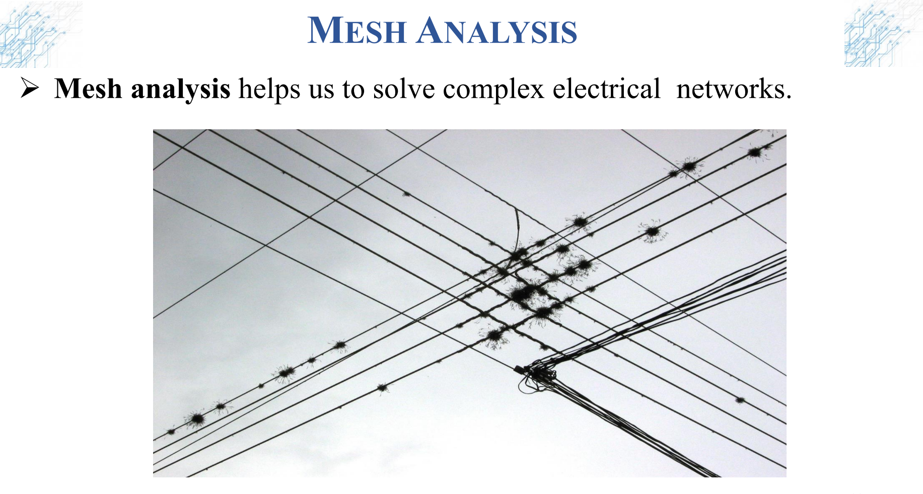

Slide 4
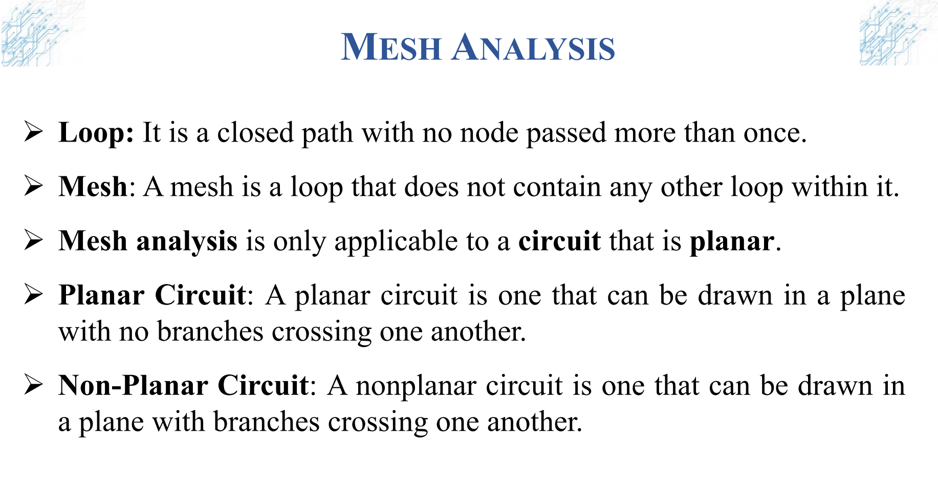

Slide 5
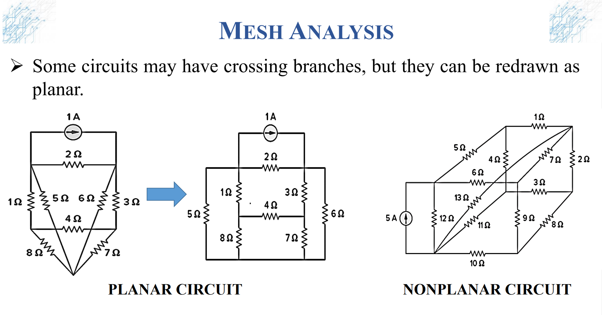

Slide 6
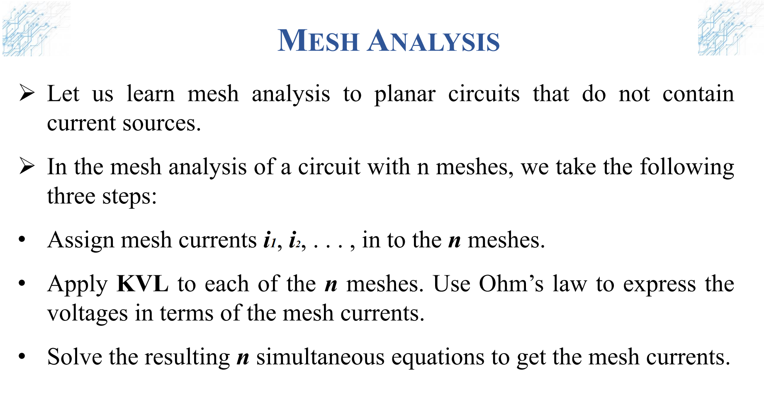

Slide 7
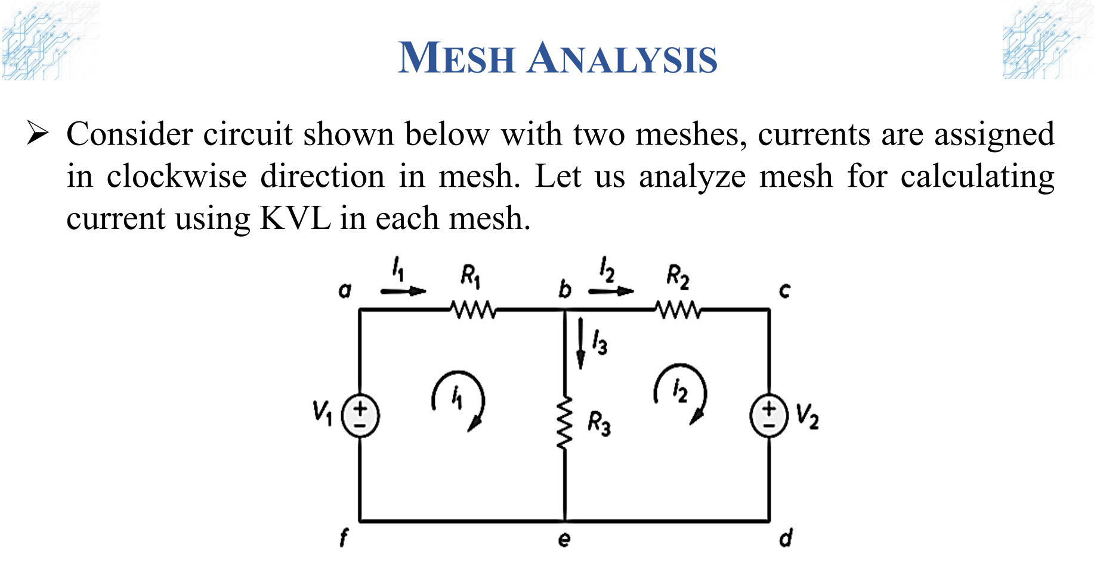

Slide 8
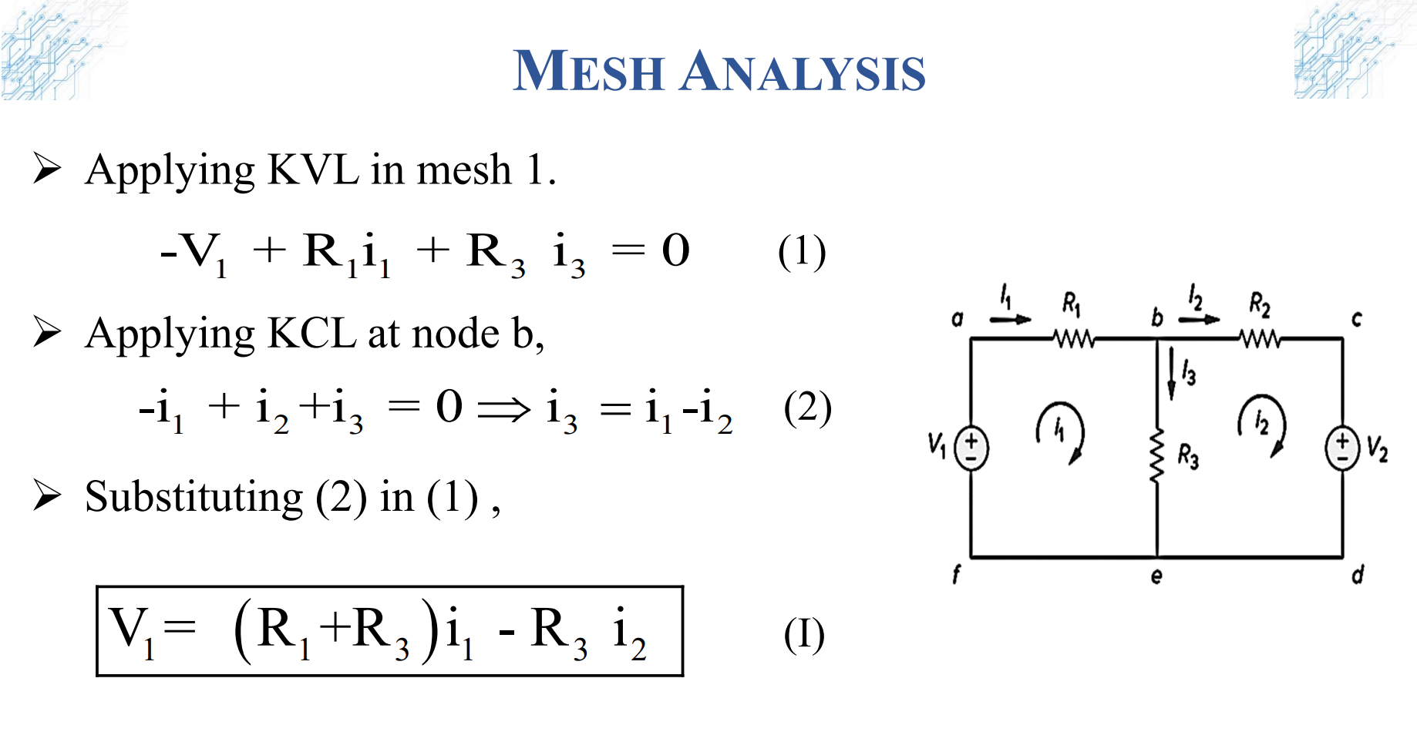

Slide 9
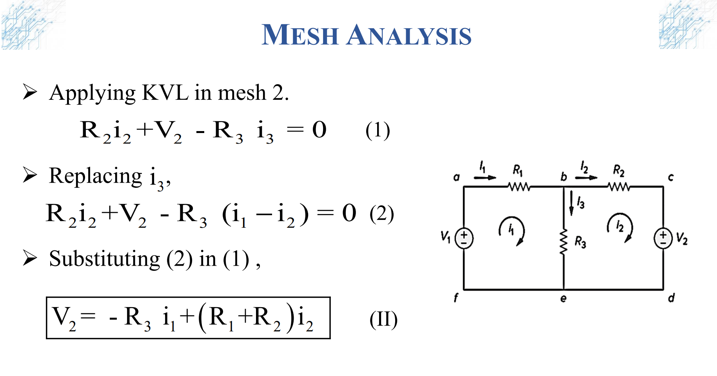

Slide 10
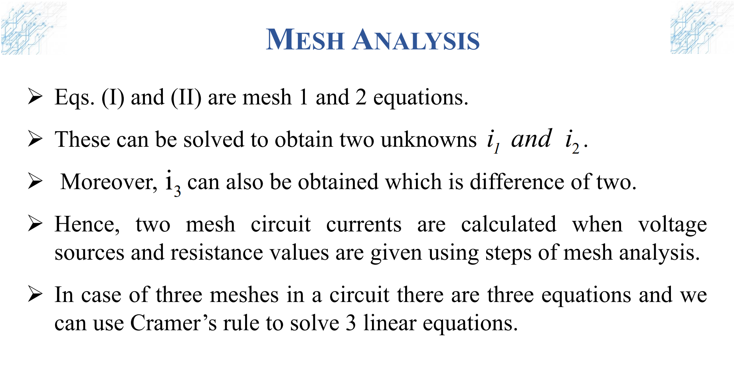

Slide 11
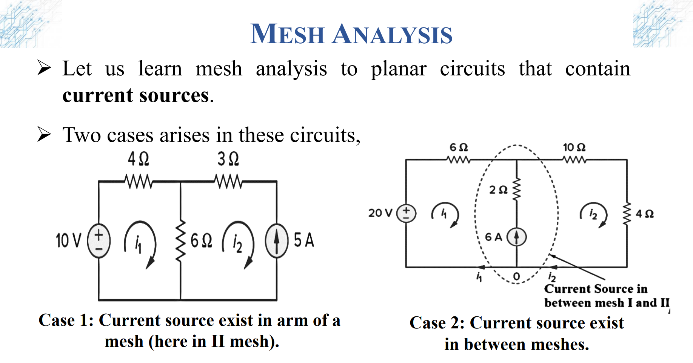

Slide 12
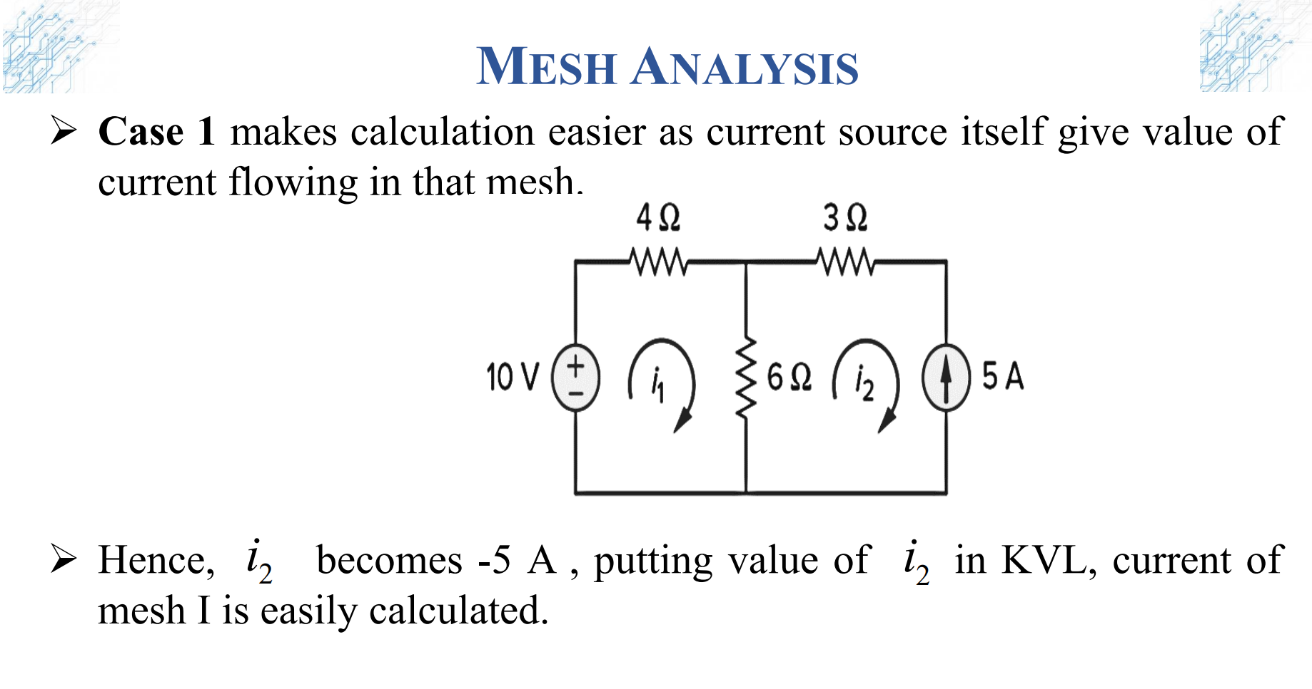

Slide 13
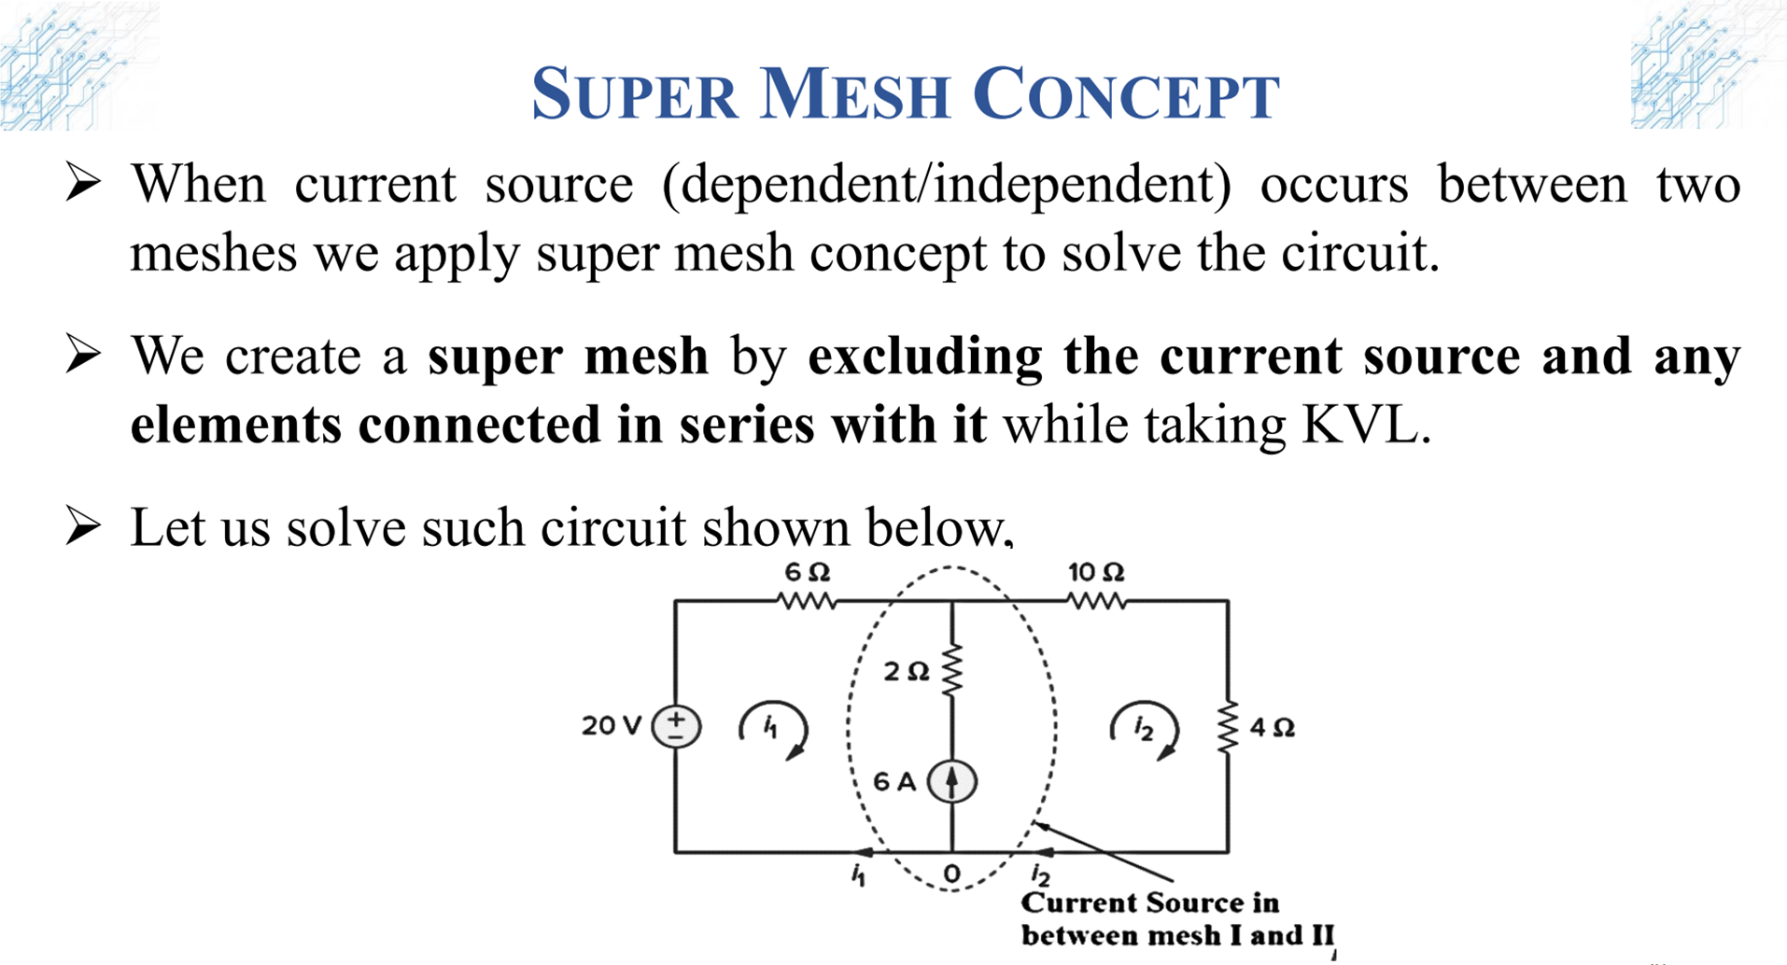

Slide 14
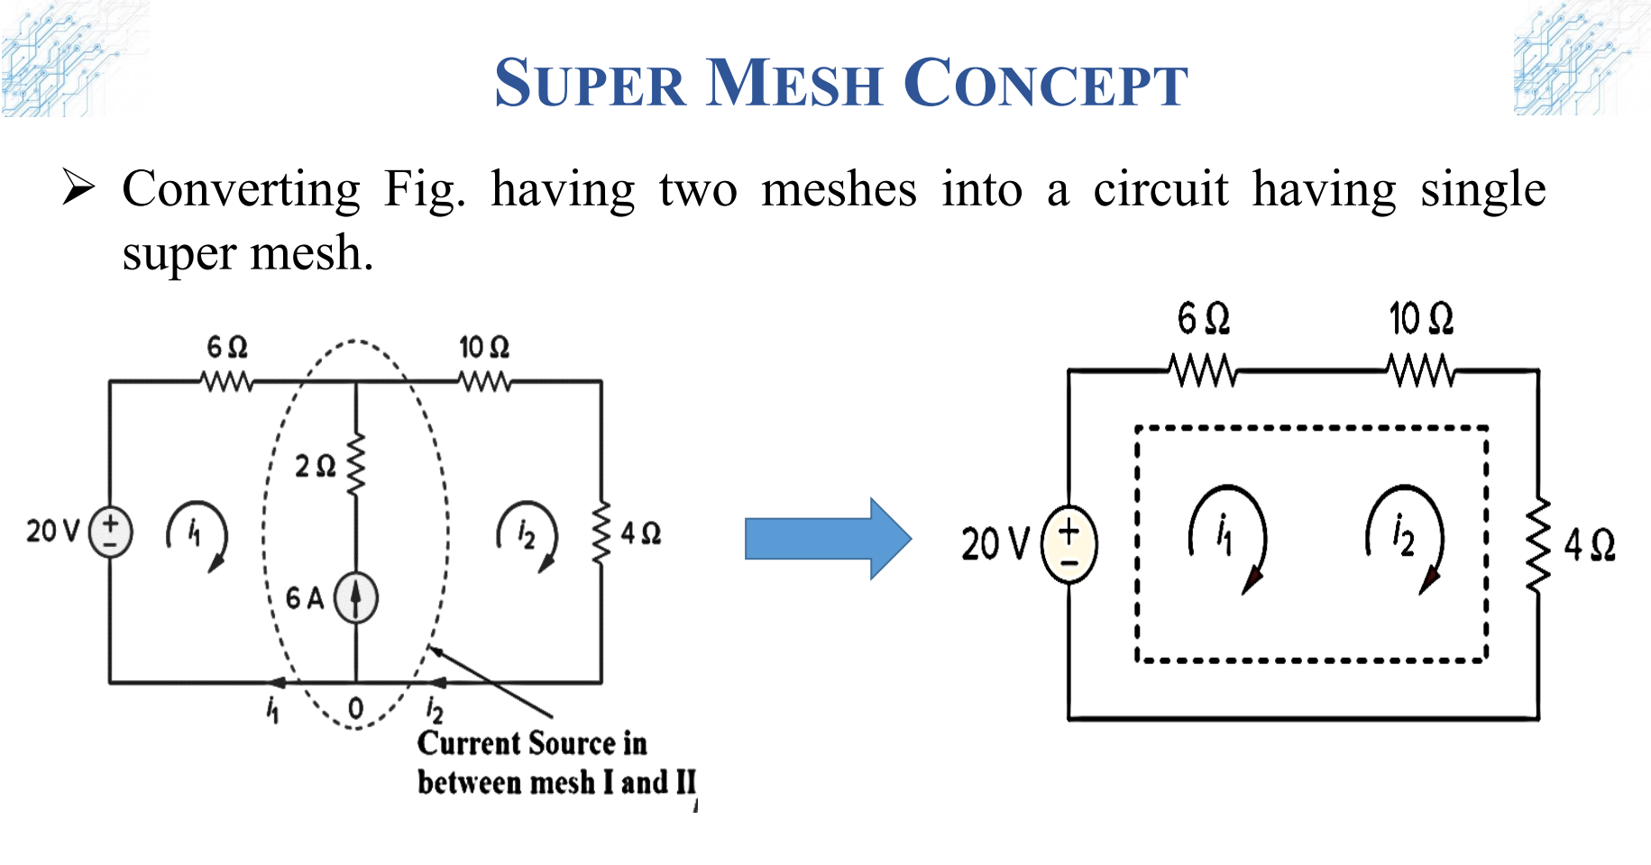

Slide 15
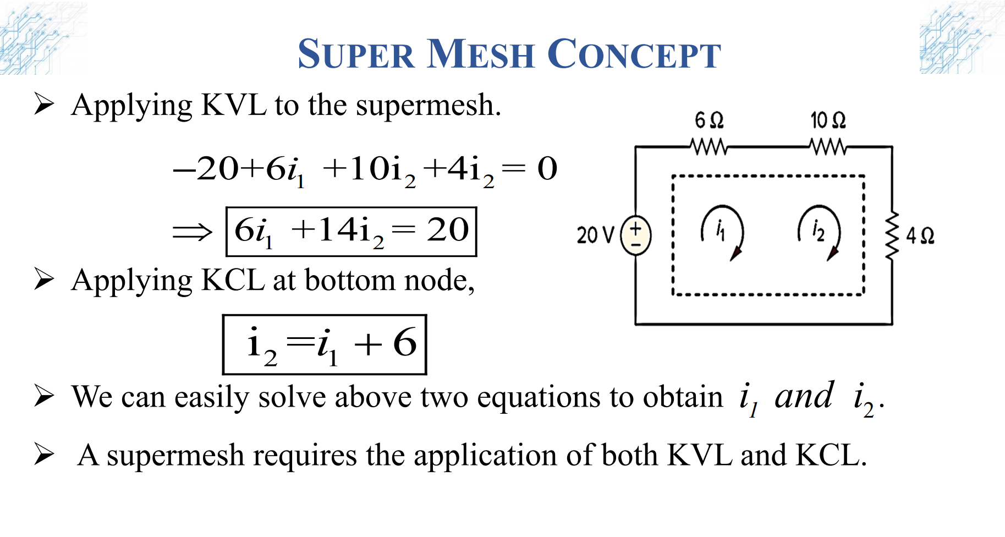

Slide 16
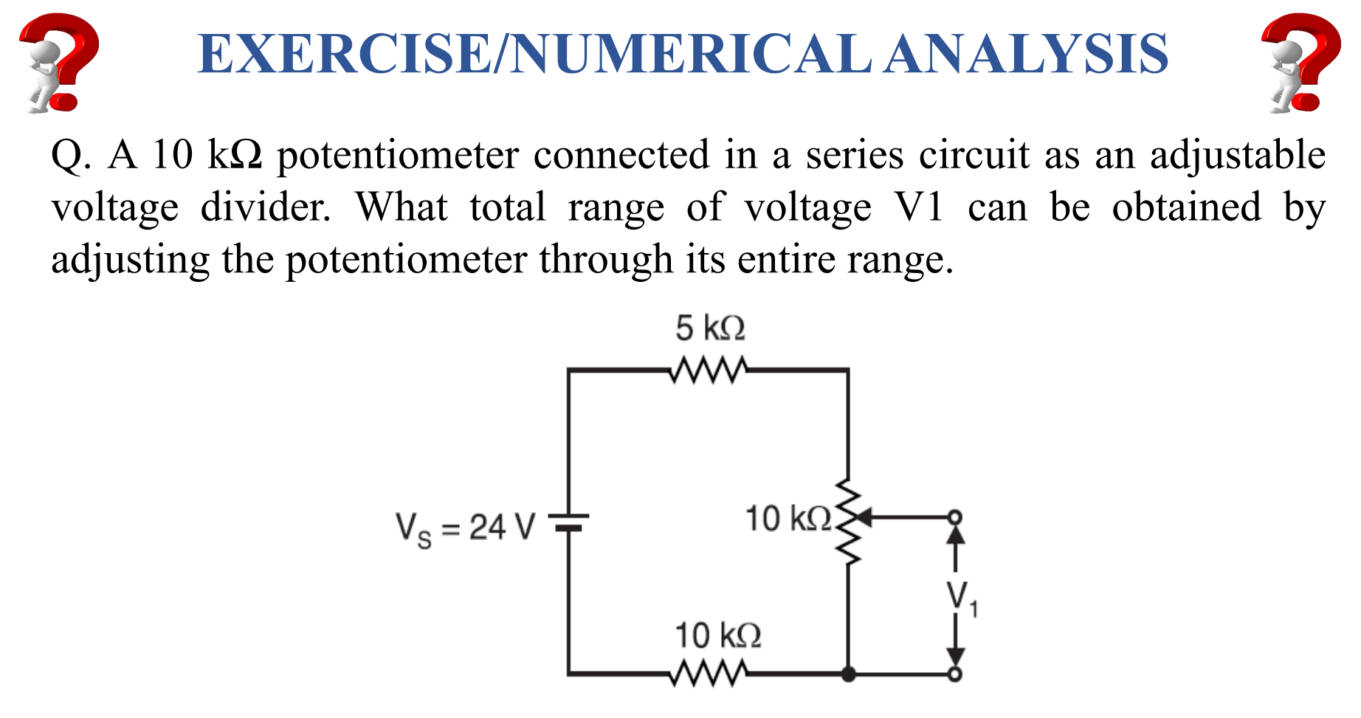
Notes:
Given:
Vs = 24 V (Supply voltage)
Resistor R1 = 5 kΩ
Resistor R2 = 10 kΩ
Potentiometer Rp = 10 kΩ (connected in series)
V1 is the voltage across the potentiometer
Solution:
The potentiometer Rp is connected in series with R1 and R2. The total resistance in the circuit is:
Rtotal = R1+Rp+R2 = 5 kΩ+10 kΩ+10 kΩ = 25 kΩ
The total current I in the circuit is:
I = Vs * Rtotal = 24 V * 25 kΩ = 0.96 mA
Range of V1
V1 is the voltage across the potentiometer, which is adjustable between 0 and the full resistance of the potentiometer.
If the potentiometer is adjusted from 0 to 10 kΩ, the voltage V1 across it will range from 0 to:
V1max = I * Rp = 0.96 mA * 10 kΩ = 9.6 V
Thus, the total range of voltage V1 that can be obtained by adjusting the potentiometer is: 0 V ≤ V1 ≤ 9.6 V

Slide 17
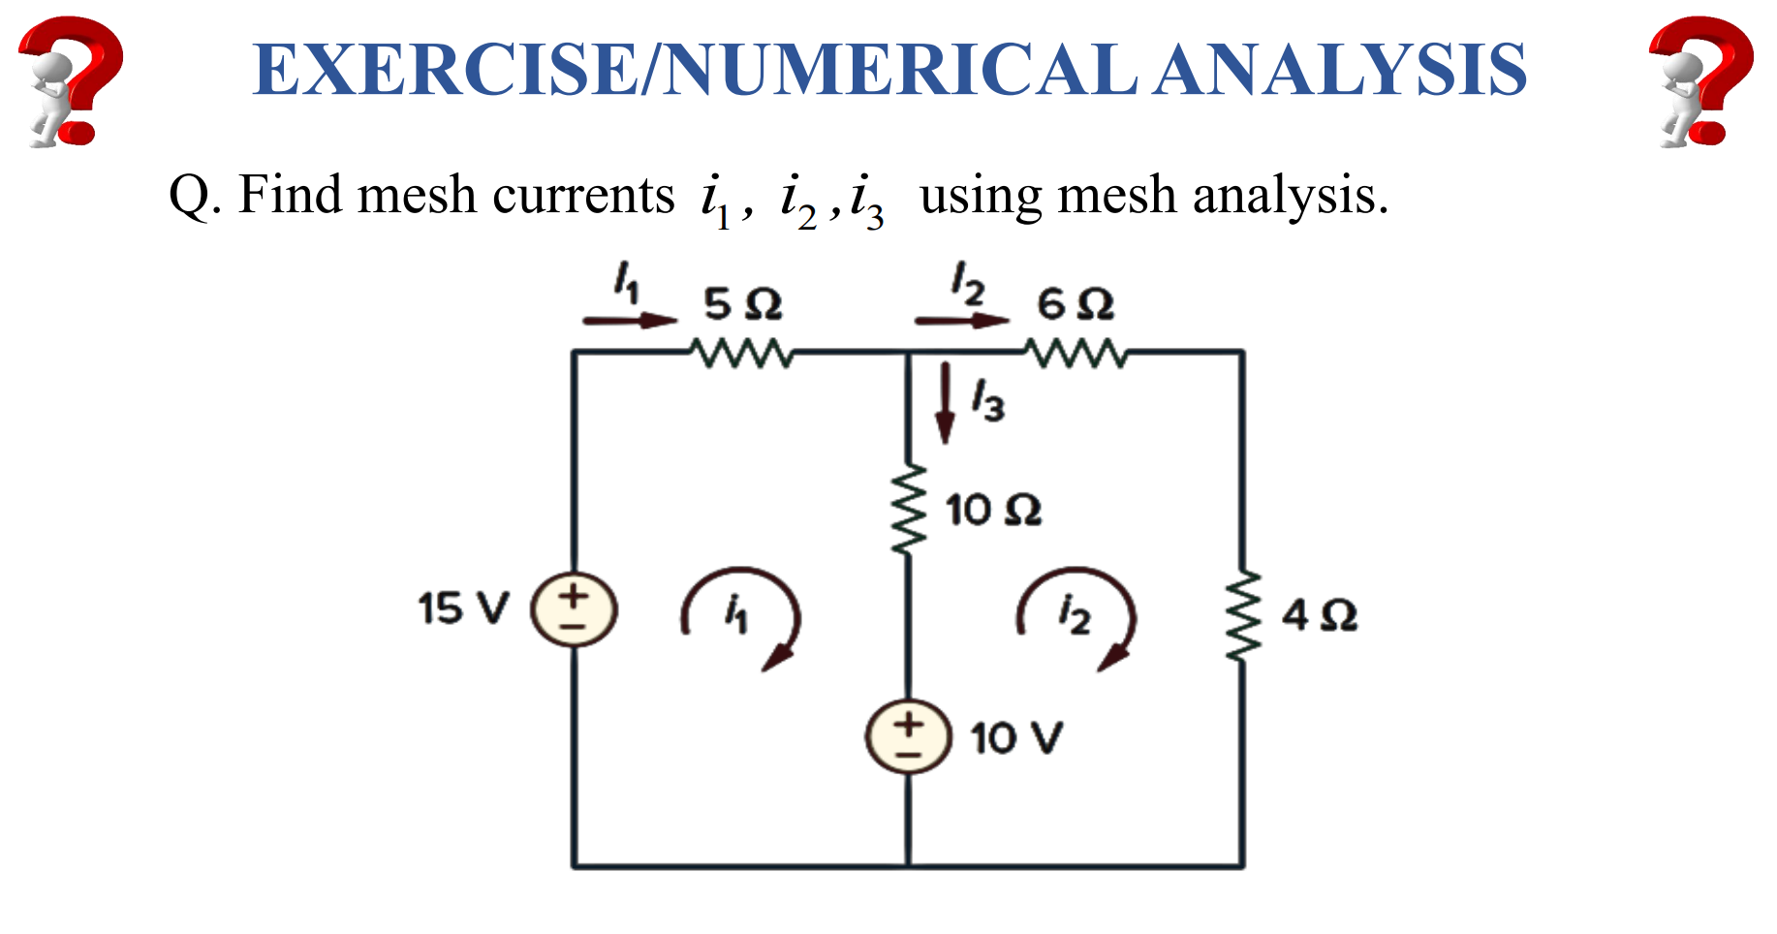
Notes:
KCL:
i3 = i1 – i2
KVL in mesh 1:
15-5*i1​-10*i3-10 = 0
15-5*i1​-10*(i1​−i2​)-10 = 0
3*i1​−2*i2 ​= 1 ……………………..(i)
KVL in mesh 2:
-6*i2-4*i2+10+10*i3 = 0
-6*i2-4*i2+10+10*(i1-i2) = 0
-i1+2*I2 = 1 ………………………(ii)
Solving (i) and (ii) we get,
i1 = 1 A
i2 = 1 A
i3 = 0 A

Slide 18
Thank You !!!

